Slide 1



CRESCENT CARE
CONSTRUCTION COMPANY
www.crescentcare.in
316/274, Saidullajab, Western Marg, Gardenof Five Sense Road, New Delhi - 110030
www.cresentcare.in

Slide 2


TABLE OF CONTENTS
  About Us
  Our Philosophy
  Our Team
  Services
  Team
  Project
  Contact Us
www.reallygreatsite.com

Slide 3

ABOUT COMPANY
We “M/s Crescent Care”, established in Delhi, India, previously known as “Sunpride Construction Private Limited”, engaged in providing various kind of Infrastructure developments & Construction services that includes Civil works, MEP works,
Firefighting works, HVAC works, Rainwater Harvesting
works, Horticultureworks, Interior and Exterior works.
www.cresentcare.in

Slide 4
OUR PHILOSOPHY
We use high quality raw material throughout our service in every field as we are one of the renowned quality centric organization and quality is our prior aim. We procure the raw material from quality driven organization that is checked at our quality inspection unit as to provide unique quality service to our esteemed clients. We offer these services after complete planning and designing of the project. We use latest and high performance machinery & equipment in our services. We provide these services in various parts of the country to make a permanent relationship with our esteemed clients.
www.reallygreatsite.com

Slide 5
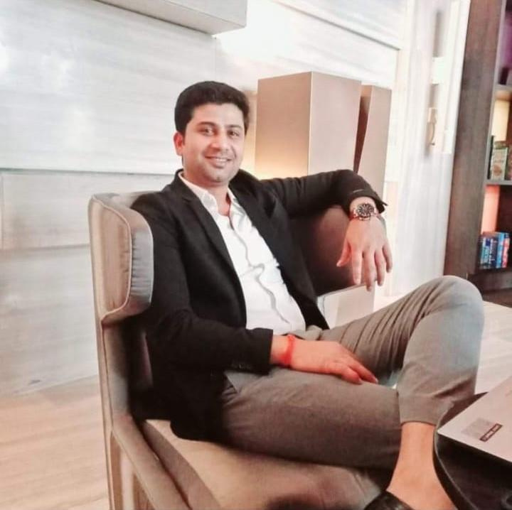
MANAGING DIRECTOR
Mr. Prithvi Singh
Mr. PRITHVIPAL, whohas achievedexcellentexposure of 12 years in civil engineering services by providing complete client satisfaction. Further He has experience in handing over the project within an agreed timeframe and budget, ensuring safety. He works closely with architects and other building professionals with Main focus in excellent planning, organizational skills and utilizing resou effectively. He has wide experience in the field of civil engineering that in Civil works, MEP works, Firefighting works, Rainwater Harvesting works Horticulture works, Interior and Exterior works, Designing works, Lubrication and Laying Service.
www.cresentcare.in

Slide 6
OUR TEAM
Mr. Aftaab
Mr. Amir Saifi
Mr. Junaid Javaidani
Project Manager :
Senior Architect:
Site Engineers:
Mr. Pushkar Phatak
Mr. Amit Thakur
Mrs. PriyankaSoni
Account Manager:
Purchase Manager:
H.R Manager:
Mr. AmitSingh
Miss. Muskan Wadhwa
Shawn Garcia
Admin :
Purchase Executive:
www.cresentcare.in

Slide 7
OUR MEP CONSULTANTS
WAC Engineers Pvt. Ltd.
Startech Pvt. Ltd.
Vaishali, Uttar Pradesh
Ghaziabad, Uttar Pradesh
• • • • •
Mechanical Engineering Water Supply Drainage Vertical Transportation
Drainage
HVAC
Mechanical Engineering Water Supply Drainage Vertical Transportation Drainage
HVAC
• • • • •
www.cresentcare.in

Slide 8

OUR VALUE
● ● ●
To enhance the quality of constructions. To sieve with best value for money and high retain on project. To acquaint client with Residential and Commercial Projects standards.
●Serve with an environment of professionalism, team work and
excellence.
●To respect all environmental rules, regulations and legal
requirements.
●To enhance customer value.
www.cresentcare.in

Slide 9
Safety Guidline
● ● ● ● ● ● ● ● ● ●
Manage and Mitigate Risk with a Safety Program. Ensure Electrical Safety at Construction Sites. Implement Strict Security and Safety Protocols. Ensure a Safe work Assessment Process in Place. Ensure Chemical Storage Safety Requirements are Strictly Followed. Ensure clear Display Signages at the Construction Site. Ensure induction before start the work. Sprinkling of water in the site areas to make the environment dust free. Minors are no allowed to enter the site premises. Adequate lighting equipment’s during night shifts.
www.cresentcare.in

Slide 10
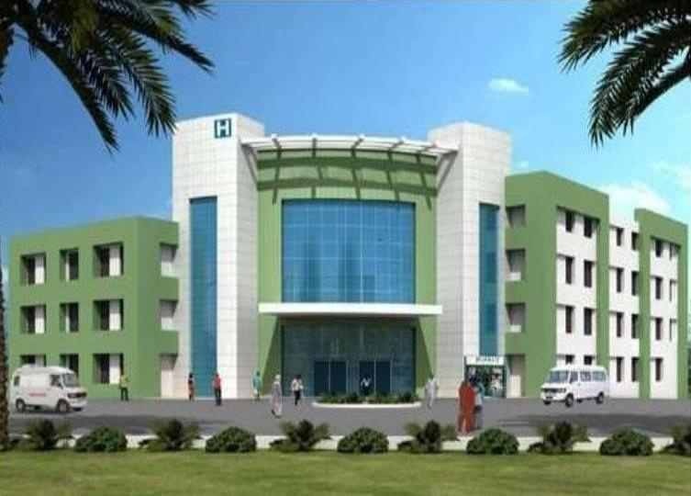
HOSPITAL
SH Hospital Rudrapur, Uttarakhand
Project Highlight
• • • •
Covered Area No. Of Beds Air-Conditioned Completion
6,500 Sq. M. 75 Yes 24 Months
COMPLETED
www.reallygreatsite.com

Slide 11
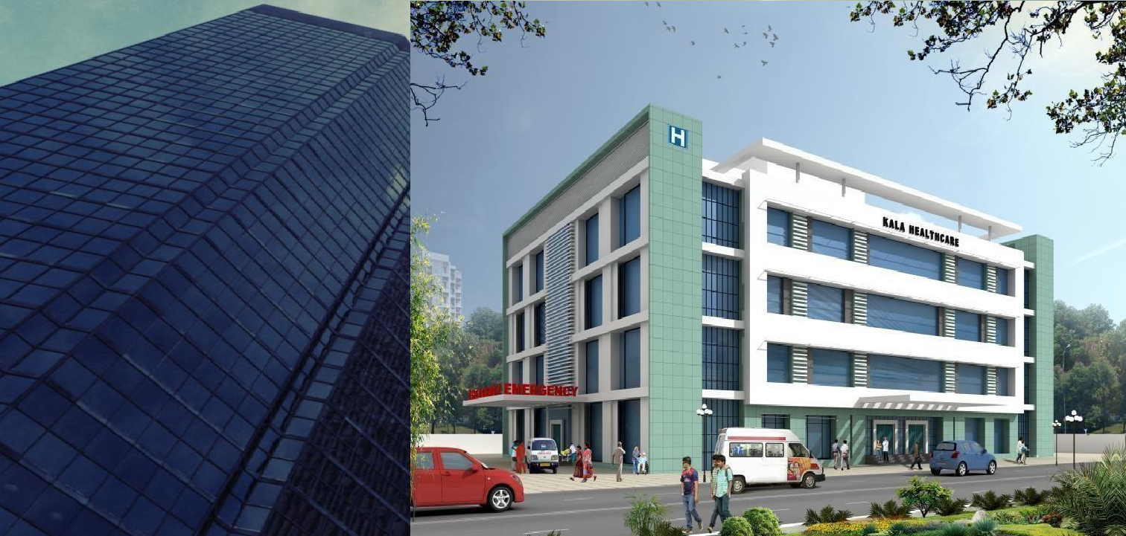
HOSPITAL
KALA Healthcare, Dehradun, Uttarakhand
We are pleased to inform you that
our company has recently
completed two major projects for
prestigious clients in the
healthcare industry. We have
successfully executed a work
order worth 140 Million for Kala
Hospital in Dehradun.
COMPLETED
www.cresentcare.in

Slide 12
Our Ongoing Projects
We are build a multispecial Hosptial KALA Healthcare in
Dehradun, Uttarakhand.
We are build Girils Hostels Buildings in
Kashmir
AIIMS Awantipora,
We are build our own Residential Buildings for Resaling in Dehradun, Uttarakhand.
www.cresentcare.in

Slide 13
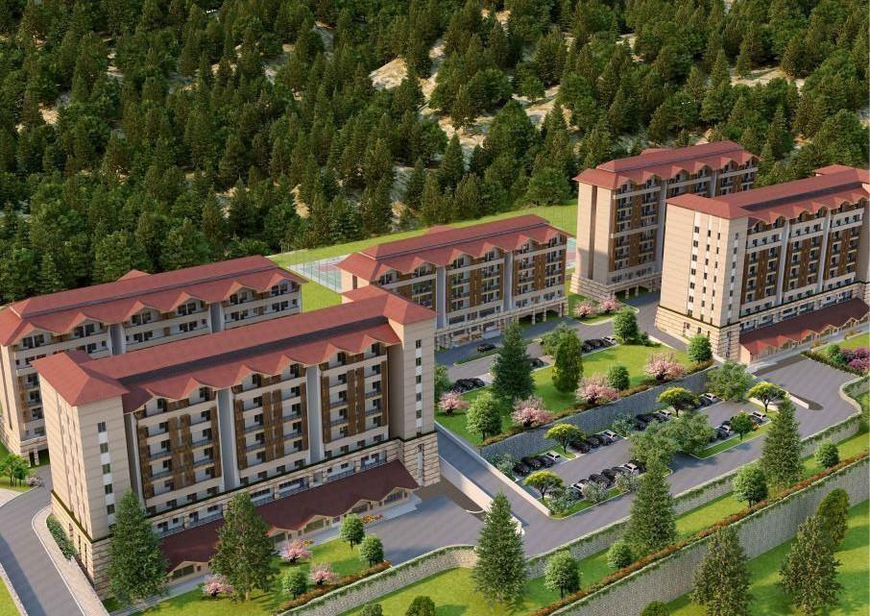

HOSPITAL
AIIMS Awantipora,
We are pleased to inform you that our
company has recently completed two
major projects for prestigious clients in
the healthcare industry. We have
successfully executed a work order
worth 160 Million for AIIMS Hospital in
Awantipura.
Project Highlight
• CoveredArea • No. Of Hostel Rooms
www.cresentcare.in
Please find attached PDF for more details:-

Slide 14
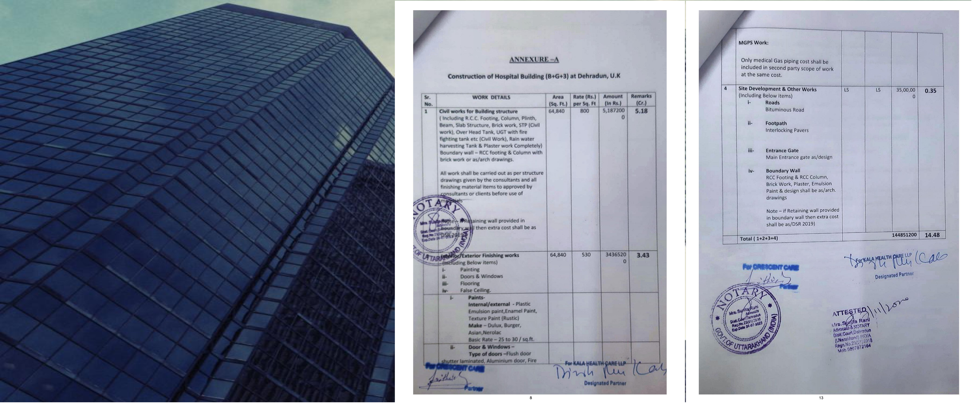



Work Order:
As we continue to expand our services in the healthcare industry, we would be honored to be considered for any upcoming projects. We believe that our experience and expertise make us a valuable partner in achieving your goals.
We are pleased to inform you that our company has recently completed two major projects for prestigious clients in the healthcare industry. We have successfully executed a work order worth 140 Million for Kala Hospital in Dehradun.
We take immense pride in delivering high-
quality work and meeting project deadlines
within budget. Our team of skilled
professionals is dedicated to providing
exceptional service and ensuring customer
satisfaction.
CONTACT US
+123-456-7890
123 Anywhere St., Any City
hello@reallygreatsite.com
www.reallygreatsite.com
www.reallygreatsite.com

Slide 15
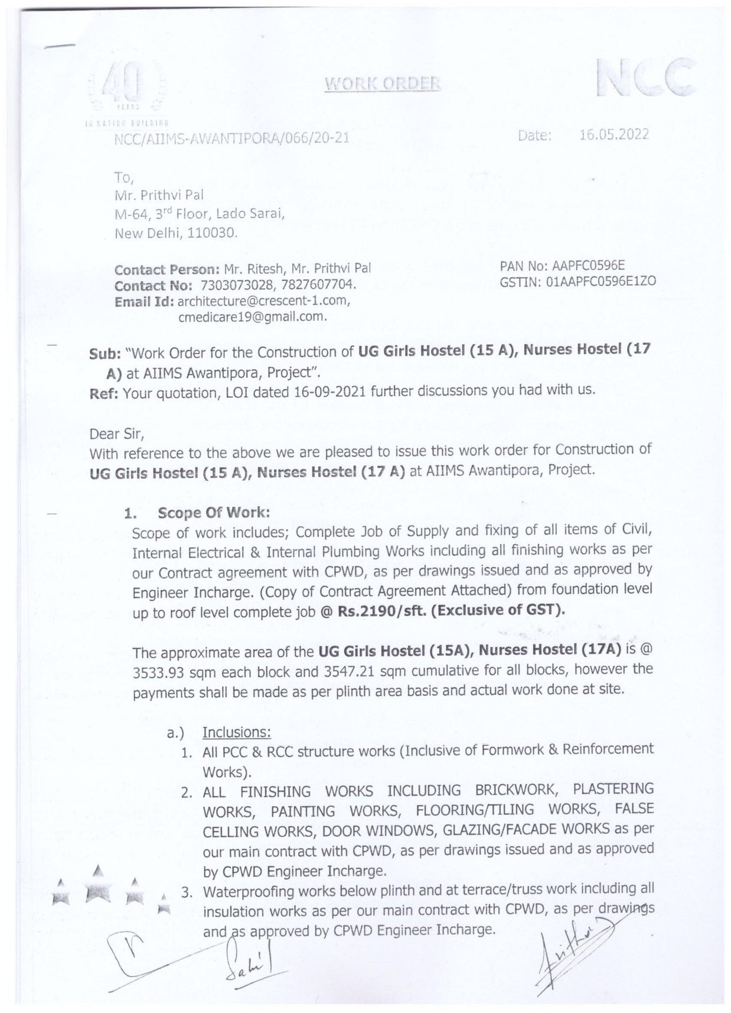

Work Order:
We are pleased to inform you that our company has recently completed two major projects for prestigious clients in the healthcare industry. We have successfully executed a work order worth 160 Million for AIIMS Hospital in Awantipura.
We take immense pride in delivering high-quality work
and meeting project deadlines within budget. Our team
of skilled professionals is dedicated to providing
exceptional service and ensuring customer satisfaction.
As we continue to expand our services in the healthcare industry, we would be honored to be considered for any upcoming projects. We believe that our experience and expertise make us a valuable partner in achieving your goals.
www.cresentcare.in

Slide 16

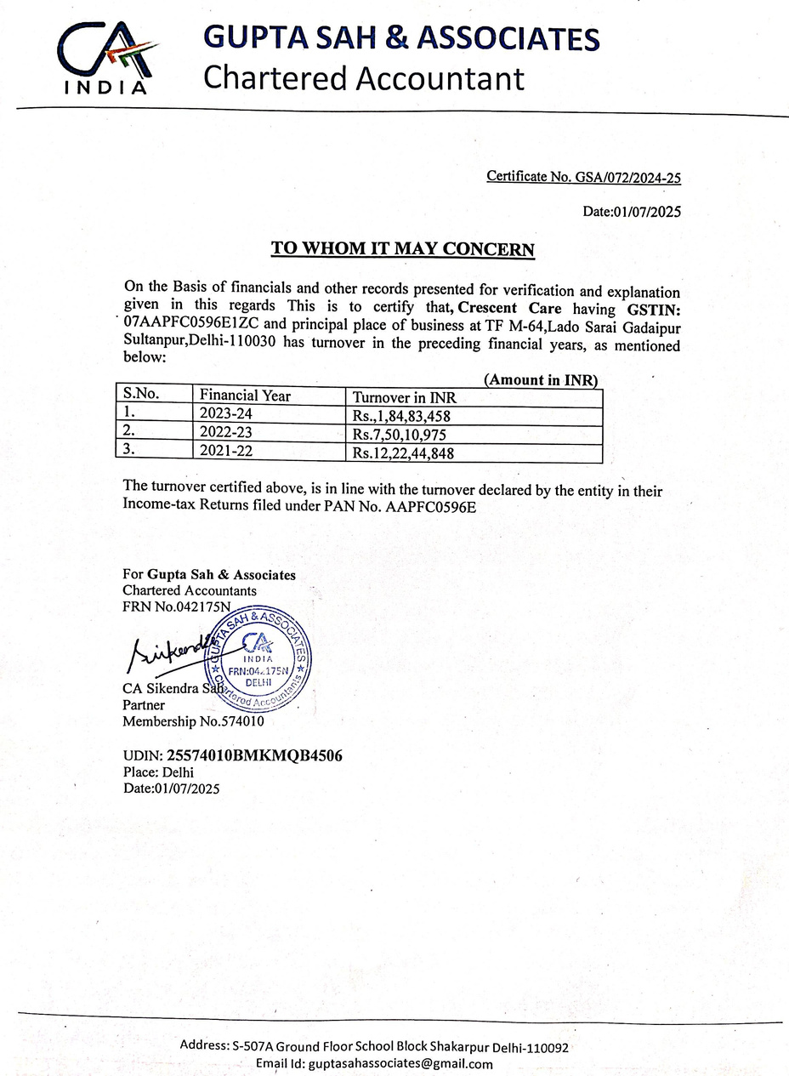
Our Turnover
We are a construction firm specializing in healthcare construction, committed to delivering high-quality projects to our clients.
One of our proudest achievements is our constantly increasing
turnover year by year. In the year of 2019-2020, our turnover
was 9.65 crore, which increased to 12.66 crore in the year of
2020-2021. We are thrilled to report this growth and attribute it
to our team's dedication, hard work, and commitment to
excellence.
At Crescent Care, we pride ourselves on delivering exceptional
results for our clients. Our team consists of highly skil led
professionals who are committed to providing innovat ive
solutions and top-notch service to ensure every project's
success. We work closely with our clients to ensure that we
understand their unique needs and requirements, and we strive
to exceed their expectations at every step of the way.
As a construction specialist, we understand the importance of
creating safe and secure environments that promote healing
and well-being. We have extensive experience in this field and
have worked on numerous projects, including hospitals, clinics,
and other healthcare facilities.
In summary, at Crescent Care, we are committed to delivering
high-quality projects and achieving exceptional results for our
Rs.7,84,83,458
www.cresentcare.in

Slide 17


THANK YOU
Get to know our company through this short presentation
316/274, Saidullajab,
Western Marg, Gardenof Five Sense Road, New Delhi - 110030
www.reallygreatsite.com

